Slide 1
Lecture 7: VSL, Defensive Behavior and Self Protection
Prof. Theising
Environmental Economics Econ 4075

Slide 2
Motivation + Roadmap
In your day-to-day, what kind of tradeoffs do you make between your health and the other features of your life?
What are examples of things that you do to help protect yourself from risk?
Wear a seat belt or a bicycle helmet, other safety items like steel toed boots or harnesses when on a roof
Personal security steps such as a passcode on your phone. Aside, what’s with the GU passwords!? Every day it’s a gamble on if we’ll have class.
Financial security such as diversifying your investments (think small, not likely many of us are managing large stock funds).
Risks to assets such as rental or auto insurance, obviously health insurance
These are useful observations because they are revealed behaviors that give insight into how people respond to everyday risks.

Slide 3
Motivation + Roadmap
In your day-to-day, what kind of tradeoffs do you make between your health and the other features of your life?
We reveal a willingness to pay for our health in both mundane and imaginative ways.
Today, we’ll talk about two key health valuation techniques commonly used to measure benefits of environmental change
Value of a statistical life (VSL)
Value implied by defensive behaviors.

Slide 4
First, a game!

Slide 5
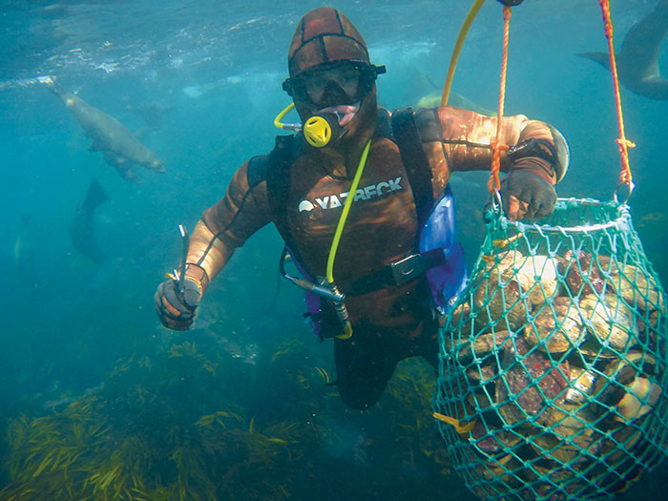
Classroom experiment
In this experiment, I’m a boat captain looking for a crew to dive for abalone.
It’s quite hard to see abalone in the dark waters; a diver has to “feel” them on the rocks, pull them off, and bring them to surface to confirm a catch.
I have three fishing grounds scoped out where I know we can catch abalone.
Abalone are represented by red cards

Slide 6
Classroom experiment
The experiment: how much do I have to pay you (in midterm EC points) to fish at each site?
You must find 3 abalone to earn your wage: You don’t bring back 3, no points!
My business needs a certain number of people to do the job – let’s say 15. I will pay the market price that assures at least 15 employees
Your task: on 3 separate sheets of paper, write down your bid price for employment – the minimum extra credit “salary” (in an increment of 0.5 points) you’ll take for the job in each of the fishing grounds.
For each fishing ground, I will pay the market-clearing wage to a randomly-chosen person with an accepted wage bid.
Stress reducer: the market clearing price will be no more than 4.5 extra credit points. If you don’t want to offer your labor, enter a bid = 5.
Labor Demand
Salary
Labor Supply
wage
1 XC pt
0.5 XC pt
7
14
18
Workers

Slide 7

Classroom experiment
What are the black cards?? (aka: the twist)
Unfortunately, there are electric eels at two of the sites. If you pick one, you’re instantly killed.
In fishing ground 1, there are no eels.
In fishing ground 2, 10% of the creatures you could grab are eels.
Chance of death: 1 – (0.9*0.9*0.9) = 27%
In fishing ground 3, 20% of the creatures you could grab are eels.
Chance of death: 1 – (0.8*0.8*0.8) = 49%
(I can’t actually kill you, but to make it a little painful/consequential: Anyone who “dies” has to prepare a 5 minute presentation of a climate-related economics paper of your choice. You’ll present it in class on 9/20, next Wednesday.)

Slide 8
Let’s go fishing!
In fishing ground 1, there are no eels.
In fishing ground 2, 10% of the creatures you could grab are eels.
Chance of death: 1 – (0.9*0.9*0.9) = 27%
In fishing ground 3, 20% of the creatures you could grab are eels.
Chance of death: 1 – (0.8*0.8*0.8) = 49%
On 3 separate sheets of paper, write down your name and your bid price for employment in each fishing ground.
Your labor bid must be in an increment of 0.5 points. You can always enter a wage bid of 5 points if you don’t want to enter the labor pool.
When you are done, please bring your bids up to me!

Slide 9
Wage Hedonics
Upon seeing the word “hedonics” up in the title, hopefully the relevance of that classroom game starts to click…
In the real world (and hopefully in the game!?), people require compensation to accept risk.
“A job can be defined by its collection of attributes.”
Responsibilities: Supervisory? Travel? Dispute management? Hiring/Firing?
Hours: Late night? Weekends? 40 hours vs. 60 hours?
Environment: Office? Outdoors? WFH?
Level of mental or physical exertion?
Risk: likelihood of injury or dying? (think: soldiers, miners, chemical workers, etc.)
In the classroom game, we experimentally isolated an aspect of the job (the risk of mortality), and studied how it impacted the market-clearing wage

Slide 10
Value of a Statistical Life
So how is this relevant?
Often we want to value public health benefits related to mortality reductions.
We want to know how much society should spend, at the margin, to save a “statistical life”.
A statistical life is a probabilistic concept.
Let’s use a simple example to gather intuition…

Slide 11
VSL: Intuition
Suppose workers must be paid an additional $5,000 to take a job that increases the annual probability of death by 0.1%, compared to a job that is identical in every other way.
So for every 1,000 workers on the riskier job, the average number of additional deaths is 1.
The extra wage paid for this “statistical life lost” is $5,000*1,000 = $5 million.
Thus, we’ve defined the value of a statistical life at $5 million.
Note, we’ve created this value based on people’s revealed behavior in the form of a market-clearing wage.

Slide 12
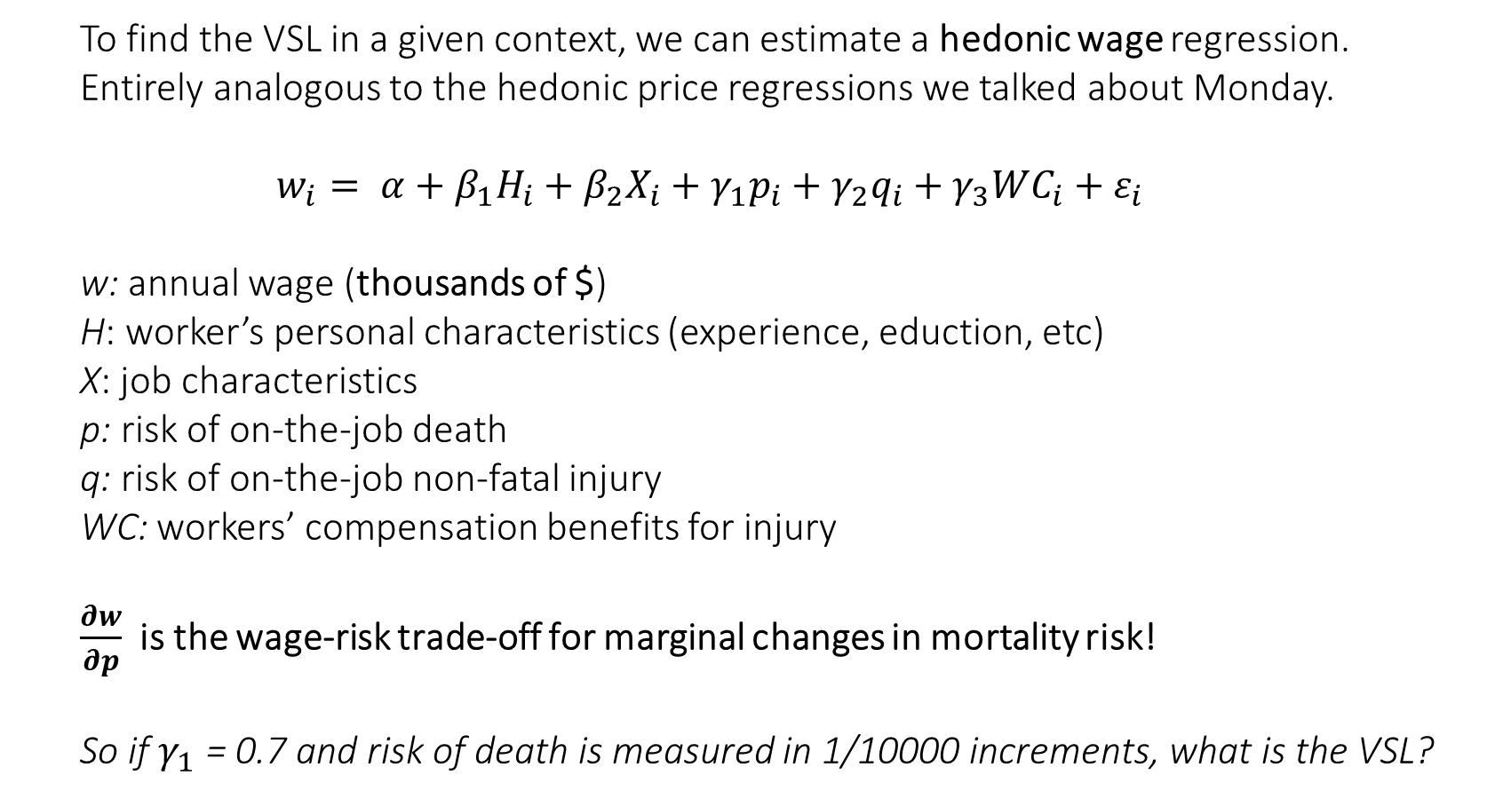
VSL: Estimation
To find the VSL in a given context, we can estimate a hedonic wage regression. Entirely analogous to the hedonic price regressions we talked about Monday.
$$w_{i}= α+β_{1}H_{i}+β_{2}X_{i}+γ_{1}p_{i}+γ_{2}q_{i}+γ_{3}{WC}_{i}+ε_{i}$$
w: annual wage (thousands of $)
H: worker’s personal characteristics (experience, eduction, etc)
X: job characteristics
p: risk of on-the-job death
q: risk of on-the-job non-fatal injury
WC: workers’ compensation benefits for injury
$\frac{∂w}{∂p}$ is the wage-risk trade-off for marginal changes in mortality risk!
So if $γ_{1}$ = 0.7 and risk of death is measured in 1/10000 increments, what is the VSL?

Slide 13
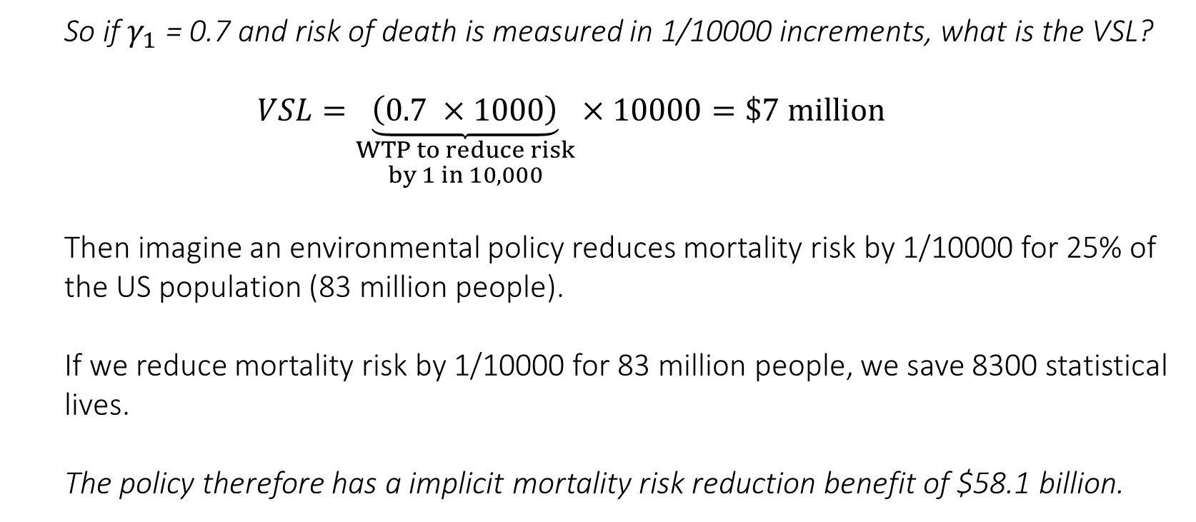
VSL: Punchline
So if $γ_{1}$ = 0.7 and risk of death is measured in 1/10000 increments, what is the VSL?
$$VSL=\underset{\begin{aligned}WTP to reduce risk \\ by 1 in 10,000\end{aligned}}{\underbrace{\left(0.7 ×1000\right)}}×10000=\$7 million$$
Then imagine an environmental policy reduces mortality risk by 1/10000 for 25% of the US population (83 million people).
If we reduce mortality risk by 1/10000 for 83 million people, we save 8300 statistical lives.
The policy therefore has a implicit mortality risk reduction benefit of $58.1 billion.

Slide 14
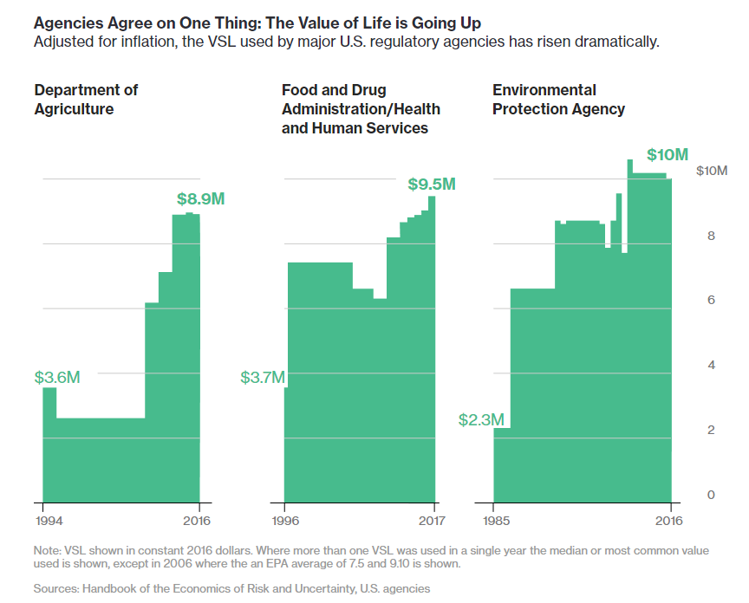
VSL: one of the most crucial statistics used by the federal government

Slide 15
Let’s shift gears a little…
When facing risk, people can typically require additional compensation (as we just discussed)
But alternatively, they can also act in a fashion that fully or partially mitigates the existing risk…
Such a behavioral response is known as a defensive or averting behavior, and reveals to us (the analyst) a preference we can use to value nonmarket aversion to health risks…

Slide 16
Defensive Behavior
When people are faced with a risk or danger, they are often (occasionally?) able to act in a way that reduces either their chances of facing that risk, or the severity of the bad outcome.

Slide 17
Defensive Behavior
When people are faced with a risk or danger, they are often (occasionally?) able to act in a way that reduces either their chances of facing that risk, or the severity of the bad outcome.
What are examples of things that you do to help protect yourself from risk?

Slide 18
Defensive Behavior
When people are faced with a risk or danger, they are often (occasionally?) able to act in a way that reduces either their chances of facing that risk, or the severity of the bad outcome.
What are examples of things that you do to help protect yourself from risk?
Wear a seat belt or a bicycle helmet, other safety items like steel toed boots or harnesses when on a roof
Shift your outdoor exercise to a time of day when the weather is not too hot, or the air quality is good.
Financial security such as diversifying your investments (think small, not likely many of us are managing large stock funds)
Risks to assets such as rental or auto insurance, obviously health insurance

Slide 19
Defensive Behavior
When people are faced with a risk or danger, they are often (occasionally?) able to act in a way that reduces either their chances of facing that risk, or the severity of the bad outcome.
What are examples of things that you do to help protect yourself from risk?
Wear a seat belt or a bicycle helmet, other safety items like steel toed boots or harnesses when on a roof
Shift your outdoor exercise to a time of day when the weather is not too hot, or the air quality is good.
Financial security such as diversifying your investments (think small, not likely many of us are managing large stock funds)
Risks to assets such as rental or auto insurance, obviously health insurance
These are useful observations because they are revealed behaviors that give insight into how people respond to everyday risks.

Slide 20
Defensive Behavior
For nonmarket goods (or bads), there are common mitigation or abatement measures that people take to protect themselves from their environment. Can you think of any examples?

Slide 21
Defensive Behavior
There are common mitigation or abatement measures that people take to protect themselves from their environment. Can you think of any examples, applied to the following contexts?
Air Pollution
Water Pollution
Noise Pollution
Climate Change

Slide 22
Defensive Behavior
For nonmarket goods (or bads), there are common mitigation or abatement measures that people take to protect themselves from their environment. Can you think of any examples?
Air Pollution
Install air filters, air conditioners, or move away entirely
Water Pollution
Water filters, bottled water, test more frequently/drill a deeper well, move
Noise Pollution
Better windows/doors, insulation, move
Climate Change
Find a job where you can work inside, move away from the equator, live in a developed country

Slide 23
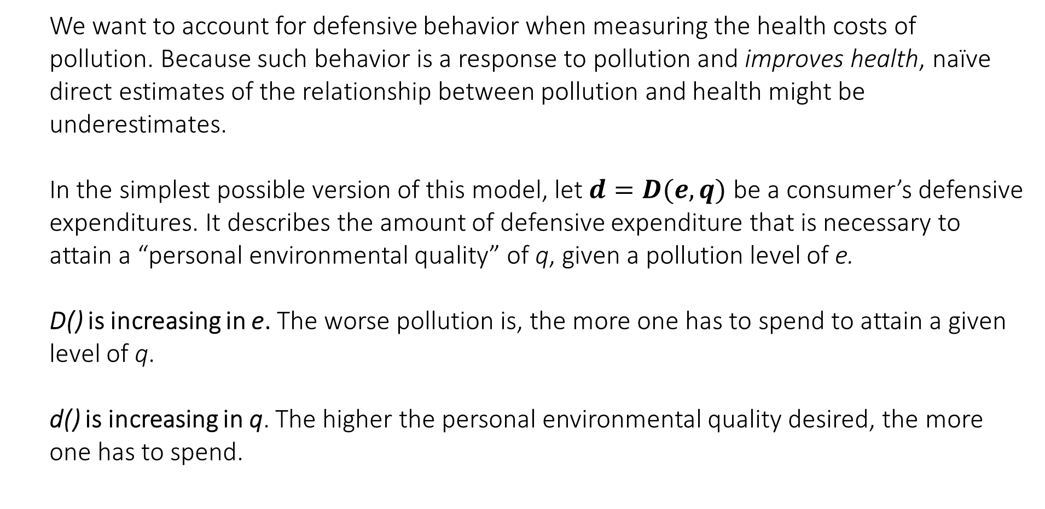
A Health Production Model
We want to account for defensive behavior when measuring the health costs of pollution. Because such behavior is a response to pollution and improves health, naïve direct estimates of the relationship between pollution and health might be underestimates.
In the simplest possible version of this model, let $d=D(e,q)$ be a consumer’s defensive expenditures. It describes the amount of defensive expenditure that is necessary to attain a “personal environmental quality” of q, given a pollution level of e.
D() is increasing in e. The worse pollution is, the more one has to spend to attain a given level of q.
d() is increasing in q. The higher the personal environmental quality desired, the more one has to spend.

Slide 24

A Health Production Model
Consumers solve:
$${}_{q,z}^{max}{ U(z,q)} s.t. \underset{(budget constraint)}{\underbrace{y=D(e,q)+z}}$$
Our usual budget constraint into objective function move: $${}_{q}^{max}{ U(\underset{z}{\underbrace{y−D(e,q)}},q)}$$
Solve for FOC:
$$\left[q\right] \frac{∂U}{∂q}=\frac{∂U}{∂z}\frac{∂D}{∂q}$$
Rearranging… (this should be looking very familiar by now!)$\frac{∂D}{∂q} = \frac{\frac{∂U}{∂q}}{\frac{∂U}{∂z}}$

Slide 25
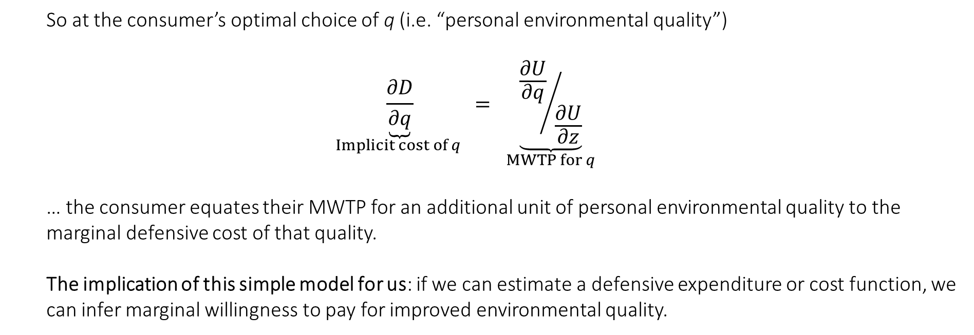
A Health Production Model
So at the consumer’s optimal choice of q (i.e. “personal environmental quality”)
$$\underset{Implicit cost of q }{\underbrace{\frac{∂D}{∂q}}} = \underset{MWTP for q}{\underbrace{{\frac{∂U}{∂q}}/{\frac{∂U}{∂z}}}}$$
… the consumer equates their MWTP for an additional unit of personal environmental quality to the marginal defensive cost of that quality.
The implication of this simple model for us: if we can estimate a defensive expenditure or cost function, we can infer marginal willingness to pay for improved environmental quality.

Slide 26
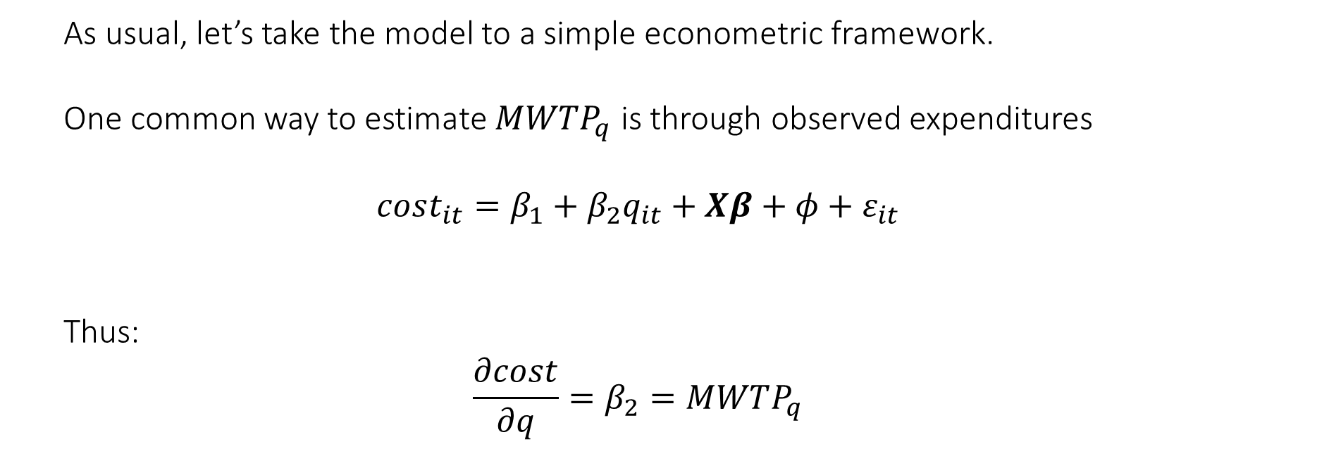
Taking the model to data
As usual, let’s take the model to a simple econometric framework.
One common way to estimate $MWTP_{q}$ is through observed expenditures
$$cost_{it}=β_{1}+β_{2}q_{it}+Xβ+φ+ε_{it}$$
Thus:
$$\frac{∂cost}{∂q}=β_{2}=MWTP_{q}$$

Slide 27
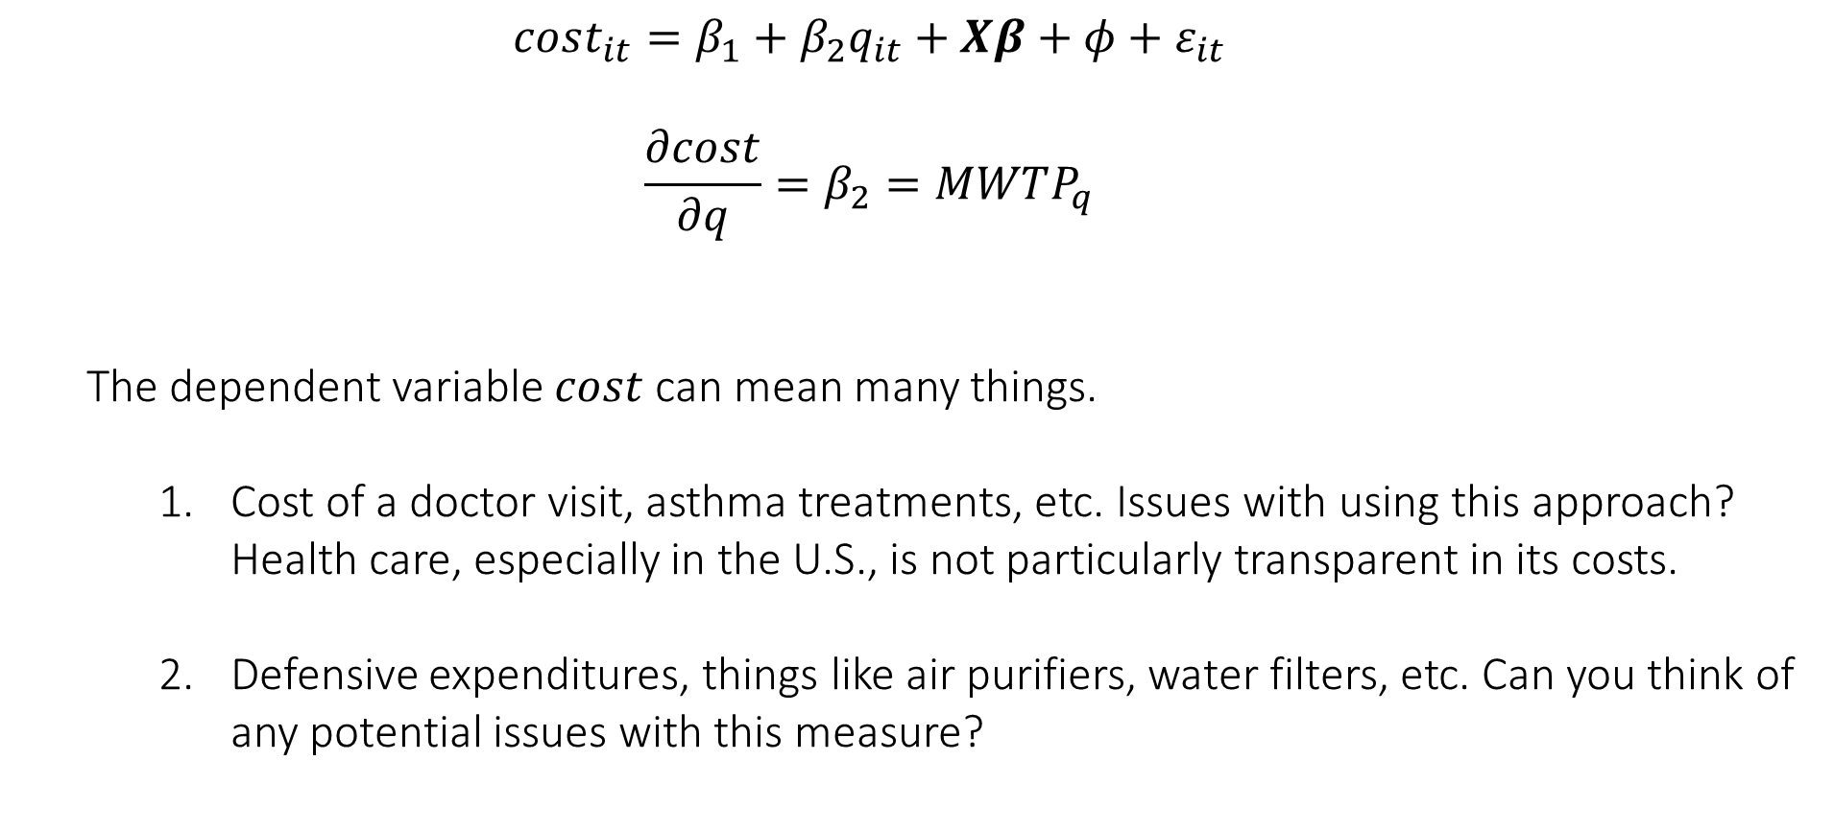
Taking the model to data
$$cost_{it}=β_{1}+β_{2}q_{it}+Xβ+φ+ε_{it}$$
$$\frac{∂cost}{∂q}=β_{2}=MWTP_{q}$$
The dependent variable $cost$ can mean many things.
Cost of a doctor visit, asthma treatments, etc. Issues with using this approach? Health care, especially in the U.S., is not particularly transparent in its costs.
Defensive expenditures, things like air purifiers, water filters, etc. Can you think of any potential issues with this measure?

Slide 28
Limitations
The practical application of this model is often challenging. Some limitations:
Defensive expenditures often represent a lower bound/partial estimate of WTP. For example, if you buy nice windows for your house, you can mitigate the effects of noise pollution indoors, but that protection stops once you go into your garden. The full value of noise reduction exceeds what is captured by measuring the cost of new windows.
Defensive expenditures create joint products. For example, if you buy bottled water to avoid pollution exposure, you might also benefit from the quality difference in taste. If you put in new windows to avoid noise pollution, you might also benefit from energy conservation.
It can be difficult to create a cost measure for defensive expenditures. For example, if you decide to keep your child indoors to avoid air pollution on a smoggy day, how would you monetize the cost?
Causal identification can be particularly challenging when considering defensive expenditures. Defensive expenditures or averting behaviors are likely correlated with susceptibility to illness, so the relationships are highly endogenous.

Slide 29
Unconventional Shale Gas Development, Risk Perceptions, and Averting Behavior
By: Wrenn, Klaiber and Jaenicke (2016, JAERE)
Research Question: Did risk perceptions about shale gas development spur defensive behavior by local residents (and if so, how large were expenditures)?

Slide 30
Unconventional Shale Gas Development, Risk Perceptions, and Averting Behavior
By: Wrenn, Klaiber and Jaenicke (2016, JAERE)
Research Question: Did risk perceptions about shale gas development spur defensive behavior by local residents (and if so, how large were expenditures)?
“Our results reveal a large, robust increase in averting expenditure associated with shale gas activity that has been overlooked in much of the existing research on potential environmental impacts of shale development and is not currently addressed in existing policy. In our preferred DDD models with time-varying treatment effects, we find per-household averting expenditure ranged from a low of $10.74 in our full sample specification to a high of $18.36 in a sample of non-metro and non-border county residents. Converting the sample average averting expenditure of $10.74 to an annual expenditure for the entire impacted population implies an averting expenditure in Pennsylvania shale counties exceeding $19 million for the year 2010 that increased from $12.9 million in 2009.”

Slide 31
Unconventional Shale Gas Development, Risk Perceptions, and Averting Behavior
By: Wrenn, Klaiber and Jaenicke (2016, JAERE)
Context:
As discussed last lecture, shale gas development ramped up in PA during 2000s. While the benefits of this development are shared globally, there are other effects (read: externalities) of the economic activity that are highly localized.
Recall: mixed body of evidence, but some suggests local health impacts from active well pads. Property value impacts found in Muehlenbachs et al (2015) suggest that well-based drinking water is the exposure pathway of concern to the public.
EPA has identified more than 1,600 different chemicals that have been used in fracking fluids. Some 200 of the chemicals are considered hazardous to human health.

Slide 32
Unconventional Shale Gas Development, Risk Perceptions, and Averting Behavior
By: Wrenn, Klaiber and Jaenicke (2016, JAERE)
Data:
Shale well locations from PA and OH Depts of Environment Protection used create county-level counts of wells
Yearly household bottled water expenditures for 2005-2010 for OH and PA (from Nielsen HomeScan panel).
Able to situate each sample household in a county.

Slide 33
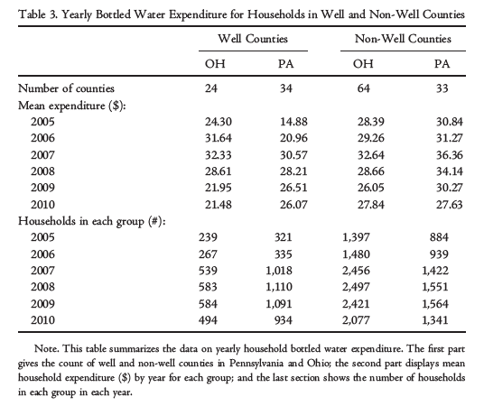
Unconventional Shale Gas Development, Risk Perceptions, and Averting Behavior
By: Wrenn, Klaiber and Jaenicke (2016, JAERE)
The data pretty much tells the story:

Slide 34
Unconventional Shale Gas Development, Risk Perceptions, and Averting Behavior
By: Wrenn, Klaiber and Jaenicke (2016, JAERE)
Empirical strategy:
General game plan is to regress household level annual bottled water expenditures on all kinds of controls + a measure of whether or not the household might be affected by local drinking water risk. We can back out a measure of average WTP for (perceived) averted risk from this.
The primary measures selected by the authors are a 0-1 indicator for whether the county had >0 shale gas wells by 2010, and a 0-1 indicator for whether the year is 2007 or later (the idea being development had taken off by then and households were more likely to be aware of potential risk after that date).

Slide 35
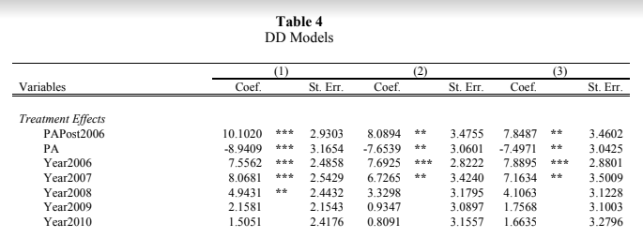
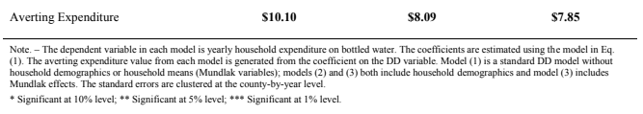

Slide 36
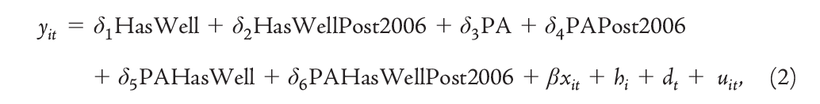
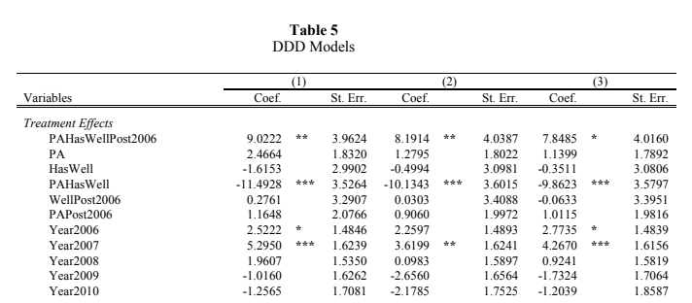
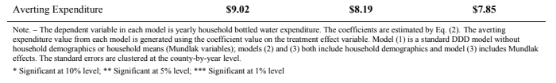

Slide 37
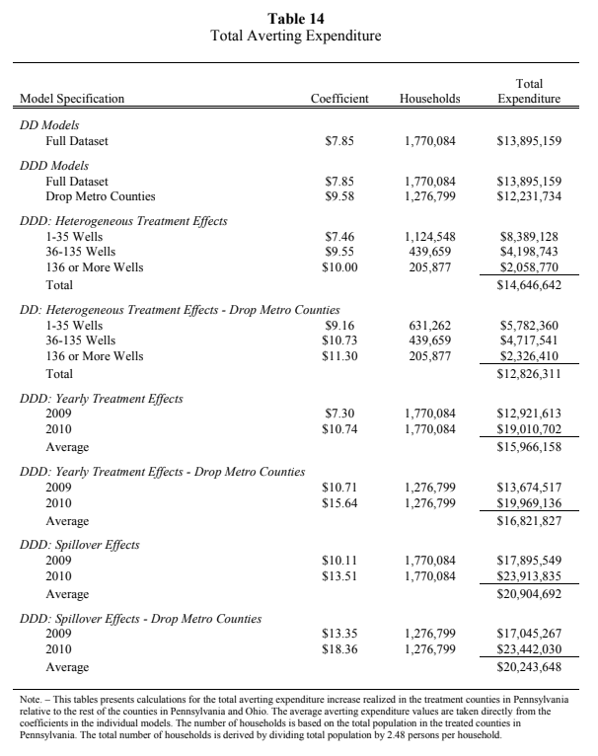
Total annual defensive expenditures in affected PA counties: $13-21 million
This is just a single damage-mitigating behavior channel affected by shale gas development; the authors call their total estimate a lower bound on potential averting expenditures.
Where else might we look to find expenditures?

Slide 38
Next Monday
A lecture on stated preference nonmarket valuation
Read Parthum & Ando (2020) and be ready to discuss
Dussaux et al (2023): optional
REMINDER: Case Study #1 – due Sunday! (September 17th by 11:59pm)

